Slide 1

topicSix
HTML Lists

Slide 2
Learning Objectives
At the end of this chapter the students should be able to:
  Specify different types of lists in web page.
  Using different types of lists appropriately
  Customized different types of list in the web page.

Slide 3
Introduction
To create a bulleted list you need to add a <ul> and a </ul> tag at the beginning and the end of the list.
Numbered lists have <ol> tags instead of <ul> tags.
To separate single list items we must use <li> and </li> tags.
There are special settings that you can use to customize the lists on your page.

Slide 4
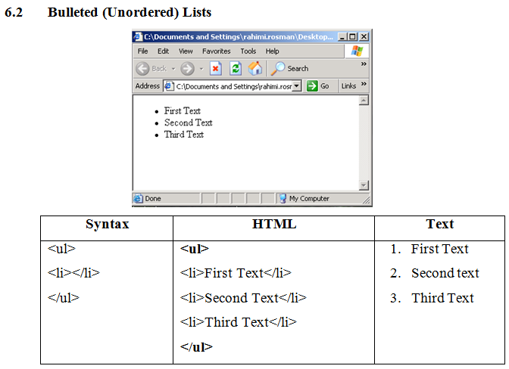

Slide 5
Bulleted List Formatting output
Just as you can change the numbering style for an ordered list, you can change the default bullet style for an unordered list with the type attribute.
The three possible values for an unordered list include:

Slide 6
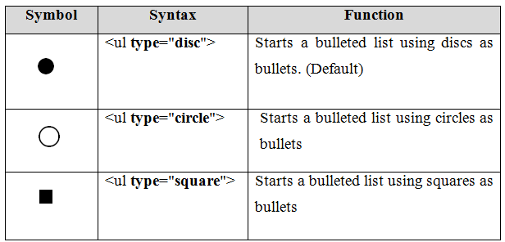

Slide 7
Bulleted List Formatting output
An unordered list is used when list items do not have any particular order.
An unordered list is created with the <ul> tag. <ul> tag also is a two sided tag and closed with </ul> tag.
You can also change the bullet type for individual list items by setting the type attribute with the <li> tag:

Slide 8
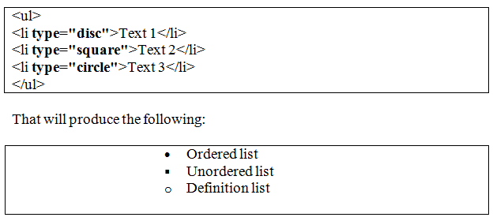

Slide 9
Numbered (Ordered) Lists
An ordered list is a numbered list. An ordered list can be used whenever a list requires sequence.
Let's assume we want to create an ordered list that displays your favorites vacation places, the most favorites is listed first and the next most important is listed second, and so on.
To create such list, we would use an ordered list as:

Slide 10
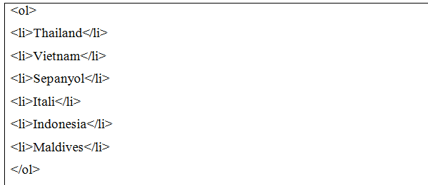

Slide 11
Numbered (Ordered) Lists
The <ol> tag starts an ordered list. The <ol> tag is a two-sided tag, which means that it also requires a closing tag </ol>.
The </ol> tag instructs the browser that the ordered list has ended.
The <li> tag is used to list each item in the list.
The <li> tag is also a two-sided tag.
Thus each item that needs to be placed in a list, should be placed inside the <li> and </li> tag

Slide 12
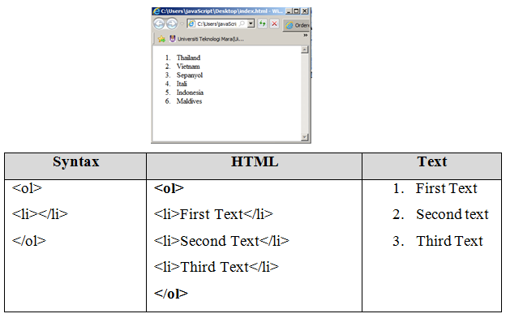

Slide 13
Change numbering style for an ordered list
The <ol> tag includes the type attribute that can be used to change numbering style for an ordered list.
This attribute can be set to one of the following choices:

Slide 14
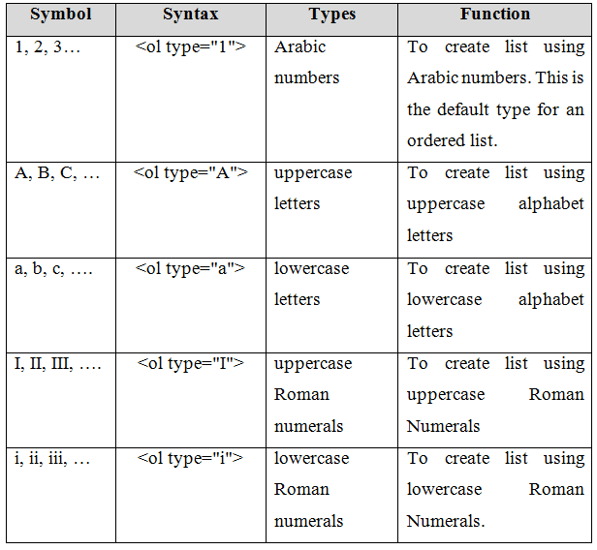

Slide 15
Changing the list value for an ordered list
With the start attribute you can set the value of the first element in the list.
For example, if you wanted to start your list with the number 5, set the start attribute to 5 and the type attribute to 1, if necessary.
You can also use the start attribute to change the list value of the first element for alphabetical or Roman numerical values.
If, for example, you wanted to start your ordered list with the letter C, set the type attribute to A and the start attribute to 3.

Slide 16
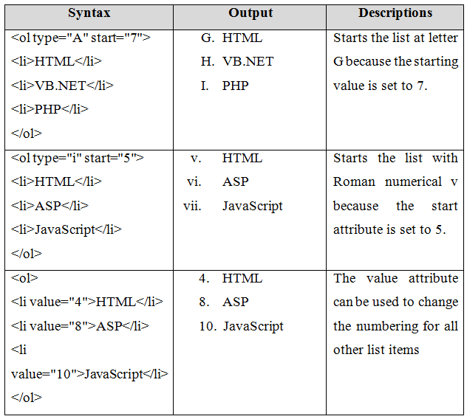

Slide 17
Custom Markers
If you want your own unique markers you can easily use your own image.
You should know that in order for the image to be visible, the image must be uploaded to the Internet (or within your folder), either to your own domain, to your blog or to one of the free picture hosting sites.
Markers are approximately 15 x 15 pixels in size by default

Slide 18
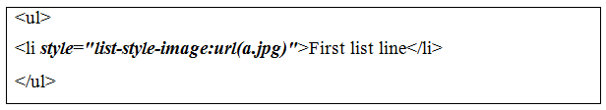
Custom Markers
If your marker image is larger than the ‘default size’, some browsers will overlap them.
In the code, there should be no spaces between url and the opening ( ).
You should use either relative or absolute URLs for the marker location.
To use custom marker, you must add a style attribute to the <li> tag:

Slide 19
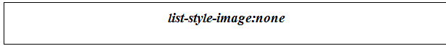
Custom Markers
You can use custom markers for the whole list or for only special lines of the list.
You can also remove custom markers by using this code in the style sheet:

Slide 20
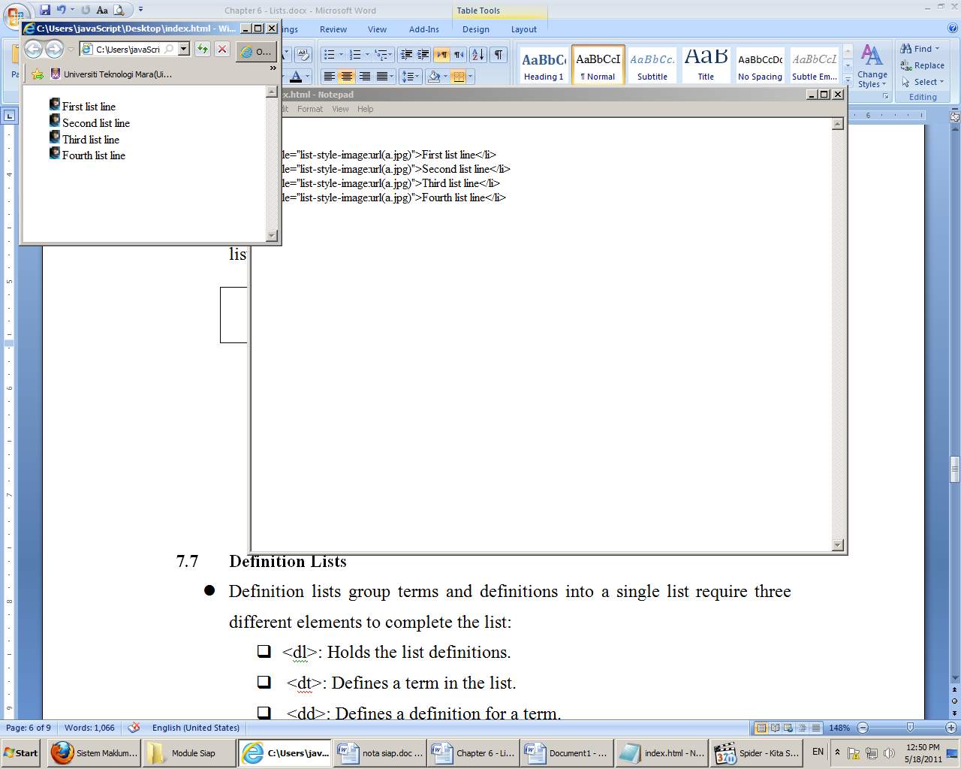

Slide 21
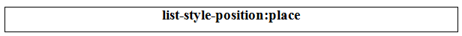
How to Control Where Markers Hang
By default all lists are indented from the left margin.
However, you can have your markers either begin halfway to the right of the starting point or flush with the rest of the text.
This last ‘hang’ is referred to as ‘inside’. To control where your markers hang, you will need to include this bit of code for the desired list or list item:

Slide 22
Place in the above tag denotes the position.
If you want the markers to begin halfway to the right of the starting point, you would use ‘inside‘ for place.
However, if you wanted the markers to display to the left of the list item text you would use ‘outside’ (default).

Slide 23
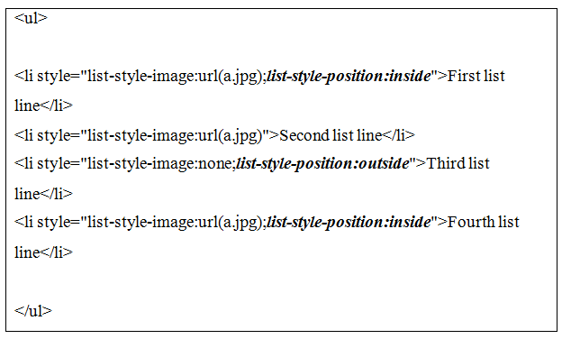

Slide 24
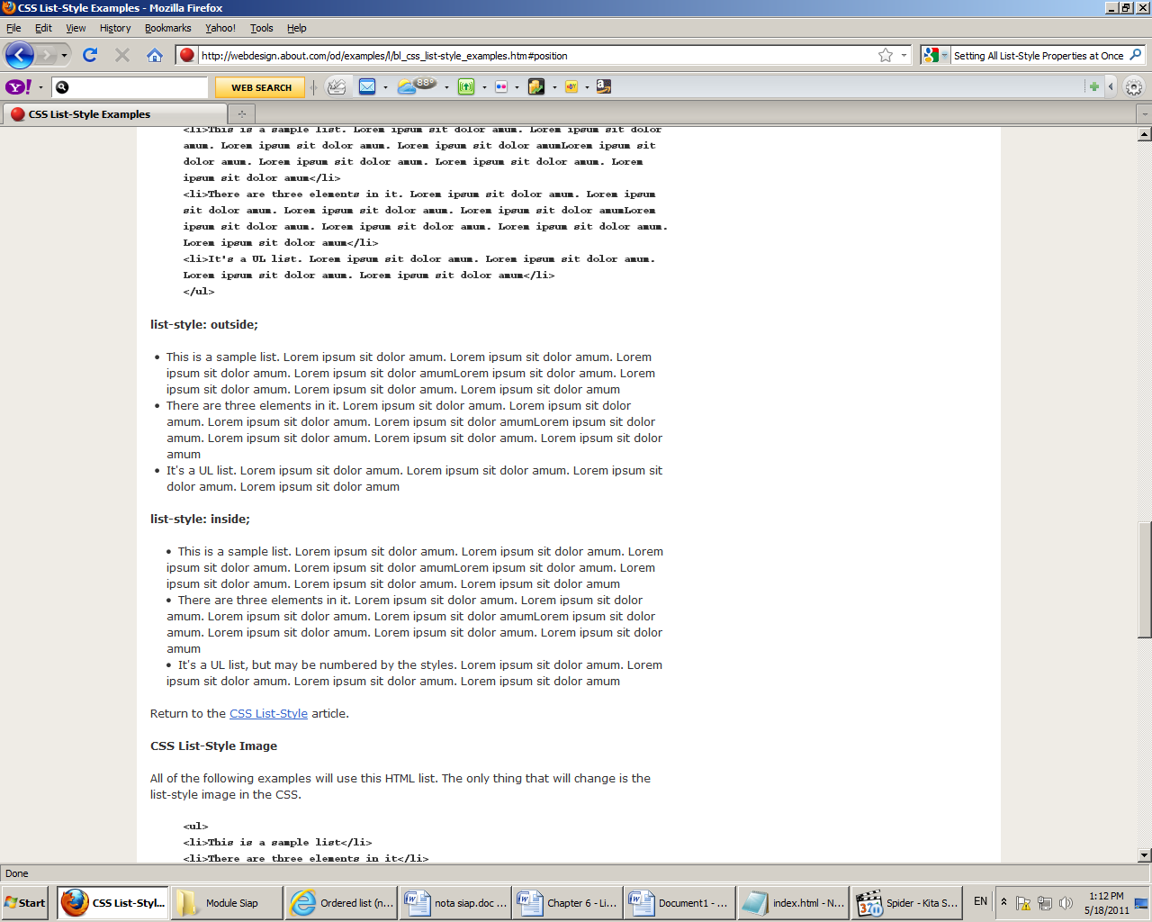

Slide 25
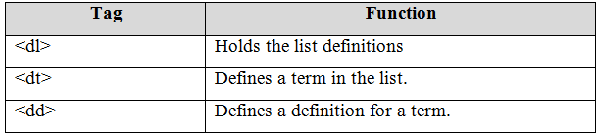
Definition Lists
Definition lists group terms and definitions into a single list require three different elements to complete the list:

Slide 26
Definition Lists
Definition list is used for displaying terms and each followed by a definition list.
A definition list starts with the <dl> tag.
Each term in the definition list is listed with the <dt> tag.
Finally, the definition for the term is listed with the <dd> tag.
You can have as many terms (defined by <dt>) in a list as you need.

Slide 27
Each term can have one or more definitions (defined by <dd>).
To create a definition list with two items requires elements and content in the following order:

Slide 28
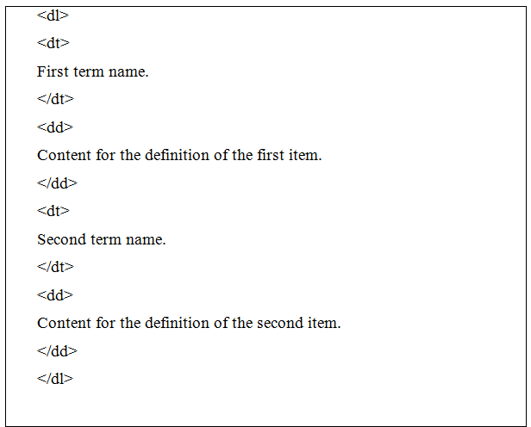

Slide 29
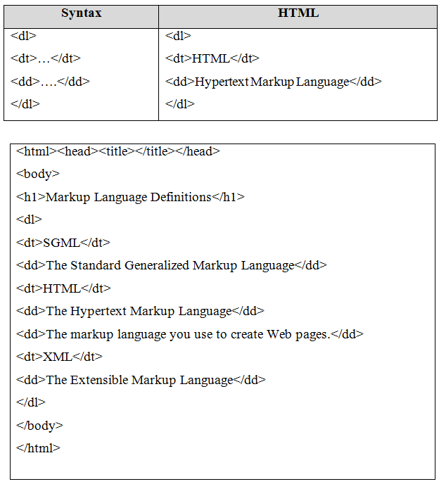

Slide 30
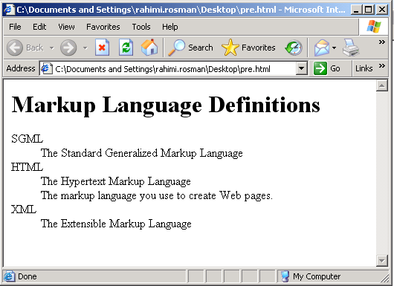

Slide 31
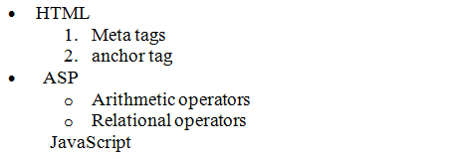
Nested list
Lists can be nested, meaning one list can be placed inside of another.
A nested list, for example, can be used to create an outline.
The following shows an example of a nested list:

Slide 32
